Slide 1


Phishing Awareness Training
This presentation will equip you with the knowledge and skills needed to identify and avoid phishing attacks.
Notes:
1

Slide 2
What is Phishing?
Definition
Goal
Phishing is a type of cybercrime where attackers use deceptive tactics to trick individuals into revealing sensitive information, such as usernames, passwords, or financial details.
The goal is to gain unauthorized access to accounts, steal money, or spread malware.
Notes:
2

Slide 3

Common Phishing Tactics
1
Urgent Messages
2
Fake Authority
Create a sense of urgency to pressure you into acting without thinking.
Impersonate legitimate organizations, such as banks or government agencies.
3
Social Engineering
Use psychological manipulation to gain trust and convince you to share personal information.
Notes:
3

Slide 4
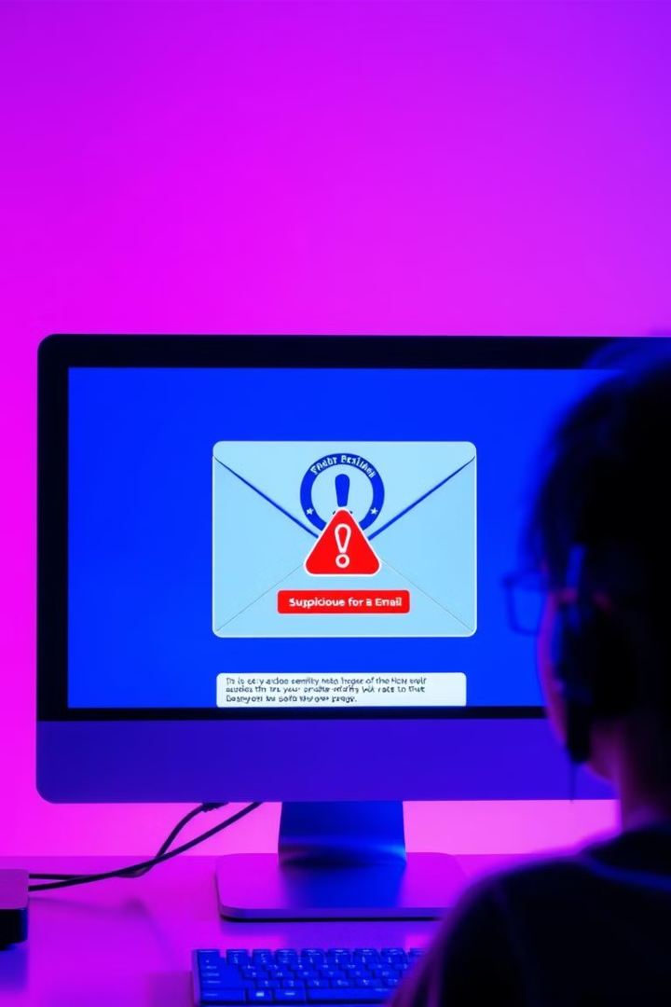

Identifying Phishing Emails
Suspicious Sender
Grammatical Errors
Check the sender's email address and domain name. Look for misspellings or unusual characters.
Phishing emails often contain grammatical errors or poor formatting.
Suspicious Links
Hover over any links to see the actual URL. Don't click on links from unknown senders.
Notes:
4

Slide 5




Phishing Website Red Flags
Missing SSL Certificate
Suspicious URL
Fake Security Notices
Look for a padlock icon in the address bar and a "https" at the beginning of the website address.
Be cautious of websites with unusual or misspelled URLs.
Don't trust pop-up messages or warnings claiming your account is compromised.
Notes:
5

Slide 6

Social Engineering Tricks
Impersonation
1
Attackers may pretend to be someone you know to gain your trust.
Scarcity
2
Create a sense of urgency or limited-time offer to pressure you into acting quickly.
Fear and Authority
3
Use fear tactics or appeal to your sense of authority to manipulate you into sharing information.
Notes:
6

Slide 7





Protecting Yourself from Phishing
Be Skeptical
Think critically before clicking on links or providing personal information.
Verify Information
Contact the organization directly to verify requests for information or account updates.
Use Strong Passwords
Create complex passwords and use a different password for each account.
Enable Two-Factor Authentication
Add an extra layer of security by requiring a second verification factor.
Notes:
7

Slide 8



Reporting Suspected Phishing Attempts
Forward the Email
1
Forward the email to your IT department or security team.
Report to the Organization
2
Contact the organization that was impersonated to report the phishing attempt.
File a Complaint
3
Report the phishing attempt to the Federal Trade Commission (FTC) or other relevant authorities.
Notes:
8

Slide 9
Best Practices for Phishing Prevention
1
Keep Software Updated
Install the latest security updates for your operating system and software.
2
Use Antivirus Software
Install and maintain a reputable antivirus program on your computer.
Be Cautious of Social Media
3
Be aware of phishing attempts on social media platforms, especially links or messages from unknown senders.
Notes:
9

Slide 10

Staying Vigilant and Keeping Up-to-Date
1
2
Stay Informed
Train Regularly
Be aware of current phishing scams and trends.
Participate in regular phishing awareness training to refresh your knowledge and skills.
Notes:
10

